Slide 1
Predicting the Effectiveness of Keyword Queries
on Databases
Date: 2013/6/10
Author: Shiwen Cheng, Arash
Termehchy, Vagelis Hristidis
Source: CIKM’12
Advisor: Jia-ling Koh
Speaker: Chen-Yu Huang

Slide 2
Outline
Introduction
Ranking robustness principle
A framework to measure structure robustness
Experiments
Conclusion

Slide 3
Introduction
Databases contain entities, and entities contain attributes that take attribute value.
Some of the difficulties of answering a query:
User do not normally specify the desired schema element for each query term.
Ex : Godfather=>title , company
The schema of the output is not specified.
Ex : Godfather=>movies, actor
Notes:
Difficult query

Slide 4
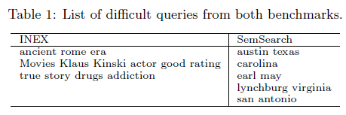
Introduction
Researchers have proposed some methods to detect difficult queries over plain text document.
In this paper, it analyzes the characteristics of difficult queries over databases and propose a novel method to detect such queries.
Notes:
This paper do

Slide 5
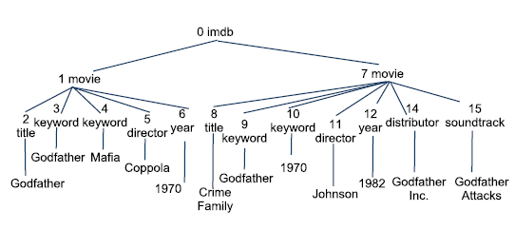
Definition
Model a database as a set of entity sets.
Entity set (S): a collection of entities E
Entity (E): a set of attribute values Ai
Attribute value (A): belongs to an attribute T (A є T)
EX:
movie : entity
title : attribute
Godfather : attribute value
Notes:
definition

Slide 6
Definition
Query (Q) : a set of terms
Q = { q1, q2, ….q|Q| }
Entity (E) is an answer to Q iff at least one of its attribute values contains a term qi in Q
Given data base DB and query Q
Retrieval function g(E, Q, DB)
Ranked list L(Q, g, DB)
Notes:
definition

Slide 7
Outline
Introduction
Ranking robustness principle
A framework to measure structure robustness
Experiments
Conclusion

Slide 8
Ranking Robustness Principle
If a text retrieval method effectively ranks the answers to a query in a collection of text documents, it will also perform well for that query over the version of the collection that contains some errors such as repeated terms.
A query to be more difficult if its rankings over the original and the corrupted versions of the data are less similar.
Use Ranking Robustness Principle as a domain independent proxy metric to measure the degree of the difficulties of queries.
Notes:
Ranking robustness priciple

Slide 9
Ranking Robustness Principle
The more diverse the candidate answers of a query are, the more difficult the query is.
EX : more entities match the term in a query
EX : each attribute describes a different aspect of an entity
Notes:
之前的method

Slide 10
Ranking Robustness Principle
Term database appear in DB1 and DB2
EX : book =>150, article => 100, movie=>10
Much harder to decide the desired entity set in DB2.
Take into account the distributions of the query term in the database as well.
DB1
DB2
book
movie
book
article
Notes:
之前的method

Slide 11
Outline
Introduction
Ranking robustness principle
A framework to measure structure robustness
Experiments
Conclusion

Slide 12
Structure robustness
A corrupted version of DB can be seen as a random sample of such a probabilistic model.
Model database DB as a triplet( S, T, A)
V : the number of distinct terms in database DB
Attribute value Aa : Xa = (Xa,1 , …., Xa,v)
Xa,j є Xa is a random variable that represents the frequency of term wj in Aa
Probability mass function of Xa :
Notes:
Ranking robustness priciple

Slide 13
Structure robustness
Attribute value set A : XA = (X1 , …., X|A|)
Xa єXA is a vector of size V that denotes the frequencies of terms in Aa
Probability mass function of XA :
The domain of x is all |A|xV matrices : M(|A| x V)
Similarly define XT and Xs that model the set of attributes T and the set of entity sets S.
Notes:
Ranking robustness priciple

Slide 14
Structured robustness calculation
Structured Robustness score(SR score)
g : retrieval function
L : ranked list
fXDB : noise generation model for database DB
Sim : the Spearman rank correlation between the ranked answer lists
Notes:
framework

Slide 15
Noise generation
Define the noise generation model fXDB(M) for database DB.
Attribute value is corrupted by a combination of three corruption levels
The value itself
Its attribute
Its entity set
Notes:
Ranking robustness priciple

Slide 16
Noise generation
The noise generation model attribute value A :
Tt : attribute
Ss : entity set
fYt,j (Ys,j) : the probability of wj to appear yt,j times in Tt
fZs,j (Zs,j) : the probability of wj to appear Zt,j times in Ss
0≤γA γT, γS ≤1 and γA+ γT+ γS = 1
Notes:
Ranking robustness priciple

Slide 17
Noise generation
The attribute value Aa is a small document, we mode fXi,j as a Poission distribution:
λa,j : the frequency of j in attribute value Aa
Similarly, model the attribute Tt and entity set Ss:
λt,j : the frquency of j in attribute Tt
λs,j : the frquency of j in entity set Ss
Notes:
Ranking robustness priciple

Slide 18
Noise generation
A mixture model overestimate the frequency of the terms that are relatively frequent in an attribute or entity set.
Noise generation model:
Notes:
Ranking robustness priciple

Slide 19
Noise generation
EX :
Query term t : ancient
Attribute Tj : plot
γT = 0.9
Ancient occurs in attribute plot: 2132 times
total number of attribute values under plot : 184731
=> λt,j = 2132 / 184731 = 0.0115
=> Probability that term t occurs k times in a corrupted plot attribute :
fYt,j (xt,j) =
Notes:
Ranking robustness priciple

Slide 20
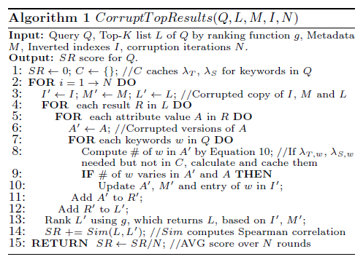
Algorithm
Top-k result
Number of corruption iterations(N)
Notes:
framework

Slide 21
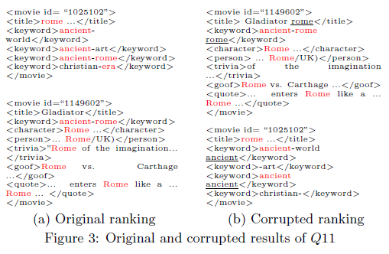
Noise generation
Q11: difficult
Notes:
framework

Slide 22
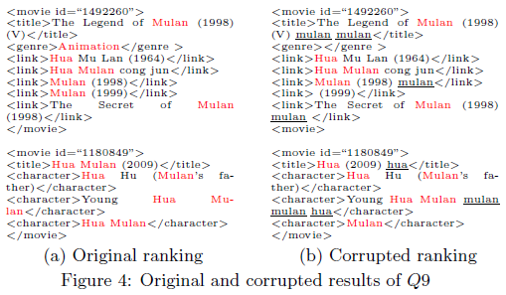
Noise generation
Q9:easy
Notes:
framework

Slide 23
Outline
Introduction
Ranking robustness principle
A framework to measure structure robustness
Experiments
Conclusion

Slide 24
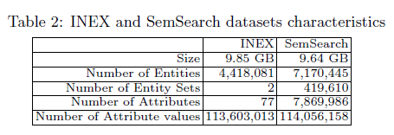
Experiment
Data set : INEX, Semantic Search
Data file : select 20
Characteristics:
Notes:
expriment

Slide 25
Experiment
Ranking algorithm : PRMS
Employs a language model approach
Top-k : k = 10 , k = 20
γA, γT, γS : train(γA, γT, γS ) by 5-fold cross validation
INEX : (1, 0.9, 0.8 )
SemSearch : (1, 0.1, 0.6 )
Notes:
expriment

Slide 26
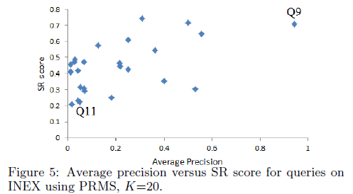
Experiment
Q9 : mulan hua
animation
Q11 : ancient
rome era
Notes:
expriment

Slide 27
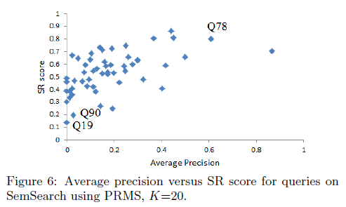
Experiment
Q78 : sharp-pc
Q90 : university of
phoenix
Q19 : carl lewis
Notes:
expriment

Slide 28
Experiment
Notes:
expriment

Slide 29
Outline
Introduction
Ranking robustness principle
A framework to measure structure robustness
Experiments
Conclusion

Slide 30
Conclusion
Introduce the problem of prediction the degree of the difficulty for queried over databases.
Set forth a principled framework and proposed novel algorithms to measure the degree of the difficulty of a query over a database.
Notes:
還要加上introduction那裏的

